Slide 1
INTEGRATED CAPSTONE PROJECT
BATCH C GROUP 4
Check Point 3
Bhavya Samhitha Mallineni | Rajiya Proddatur | Neha | Swikriti Das | Prantik Singh Chauhan
Task 2.1 Task 2.2 :- Data Transformation, Feature Engineering | Task 2.2:- Missing value treatment, Outlier treatment, Data Analysis and data scaling | Task 2.3:- Visualization using Power BI | Task 2.3:- Visualization using Power BI | Task 2.4:- Model Building using ML Algorithms

Slide 2
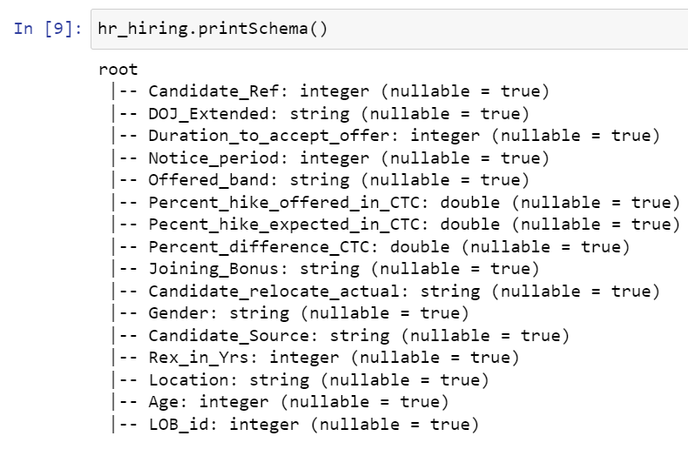
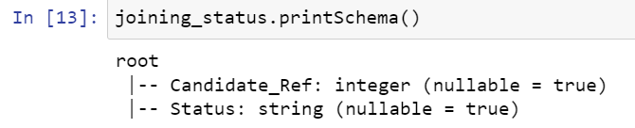
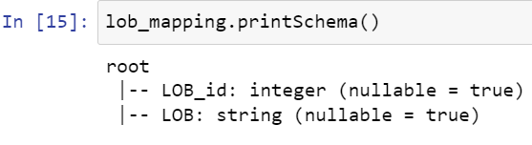
TASK 3.1 (Data Analysis using Big Data Tools)
Loading of the data from CSV files to Pyspark dataframes.

Slide 3
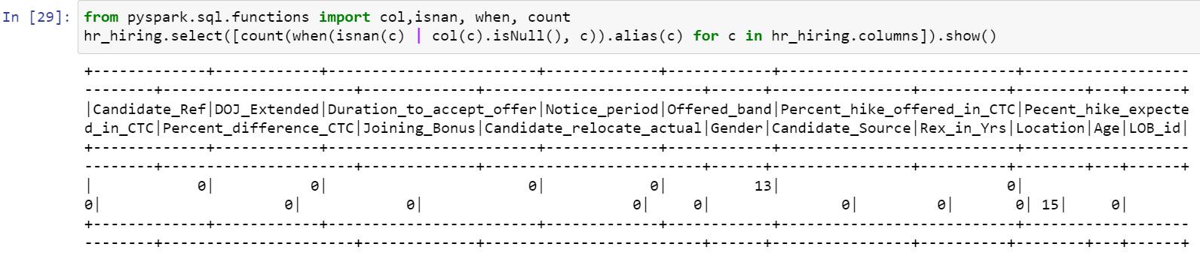
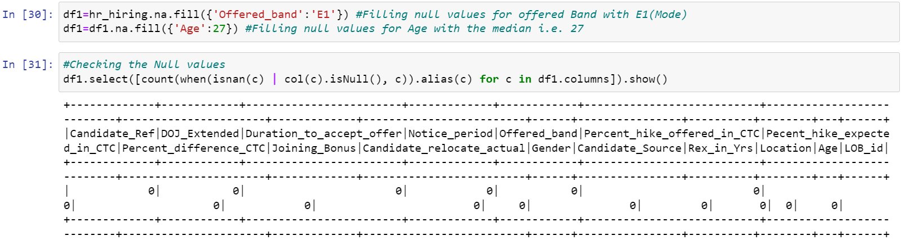
Checking the missing values
Treating the missing values for the column Offered Band and Age

Slide 4
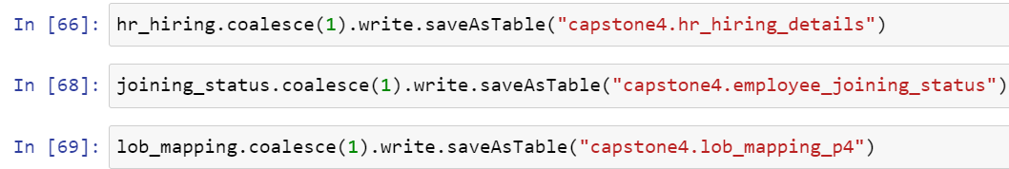
Storing the data into hive tables

Slide 5
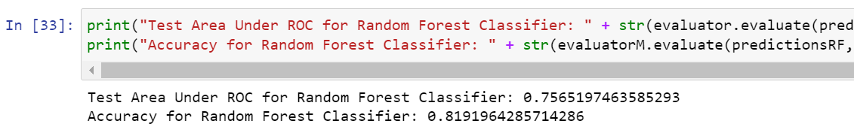
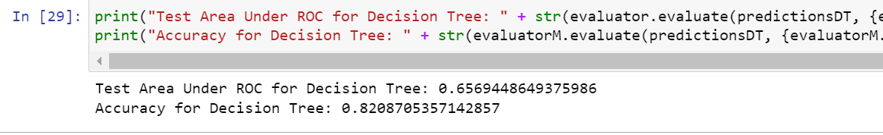
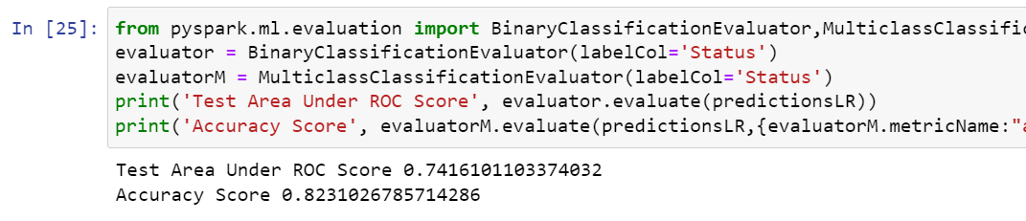
MODEL BUILDING
Random Forest
Decision Tree
Logistic Regression

Slide 6
TASK 3.2 (Data Analysis on Cloud)

Slide 7
TASK 3.3 (Deployment of Model using Flask)

Slide 8
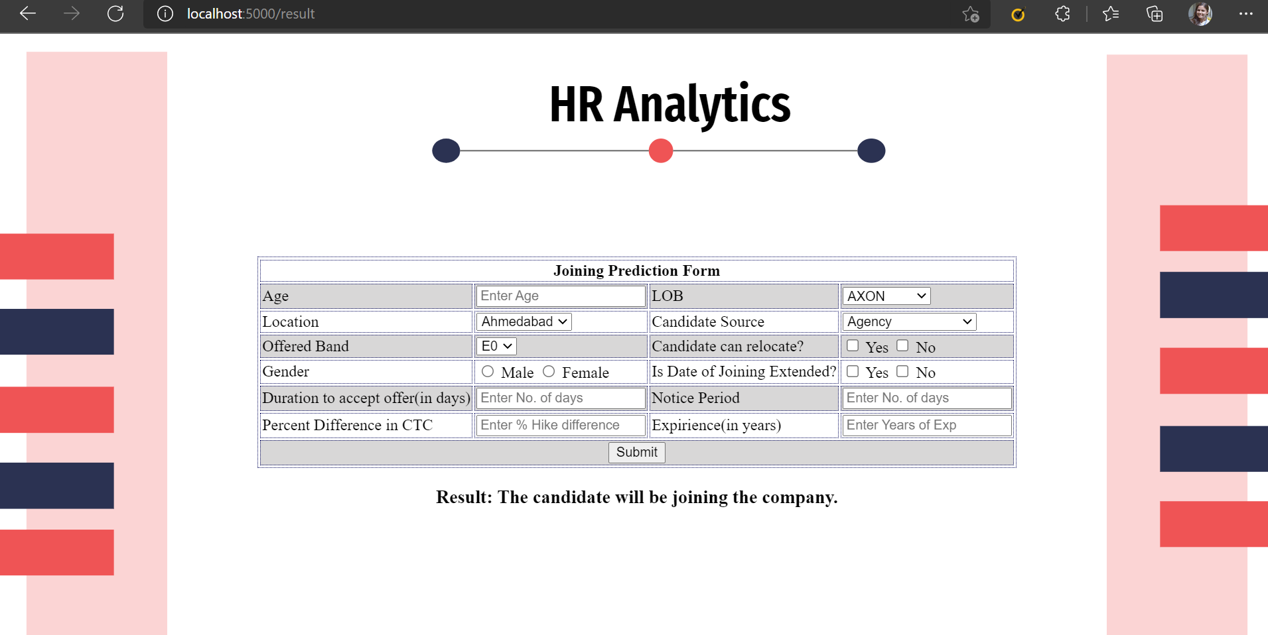

Slide 9
